Slide 1
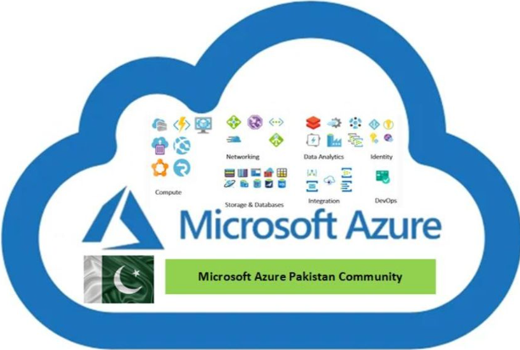

Lecturer: Vahid farahmandian
CI/CD for SQL Server Databases in Azure DevOps

Slide 2

General
Vahid Farahmandian
Born in Urmia @ 1989
Living in Tehran
CEO @ Spoota
Author

Slide 3
Why Database DevOps is Important?

Slide 4
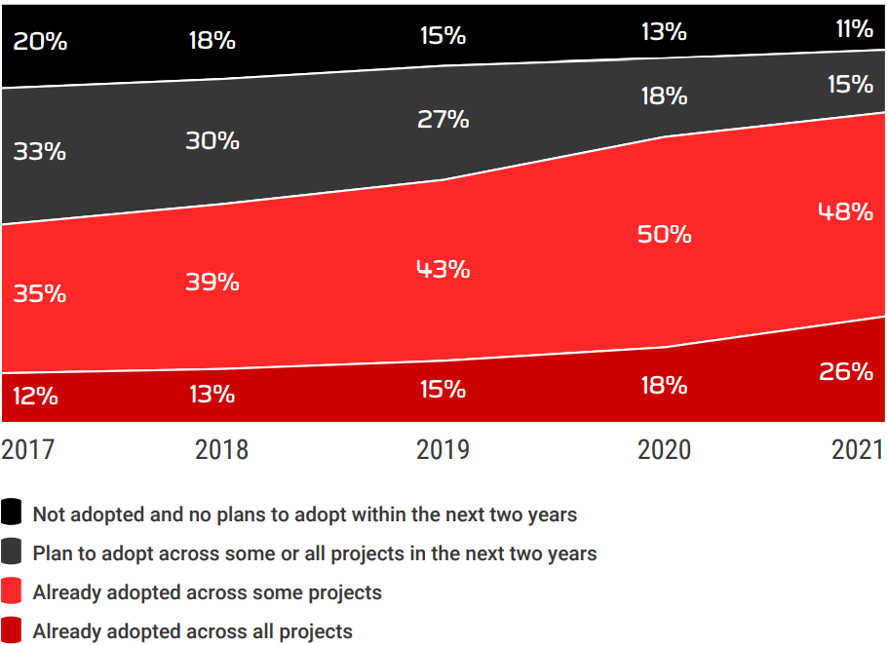
Adoption rates of DevOps, 2017-2021

Slide 5
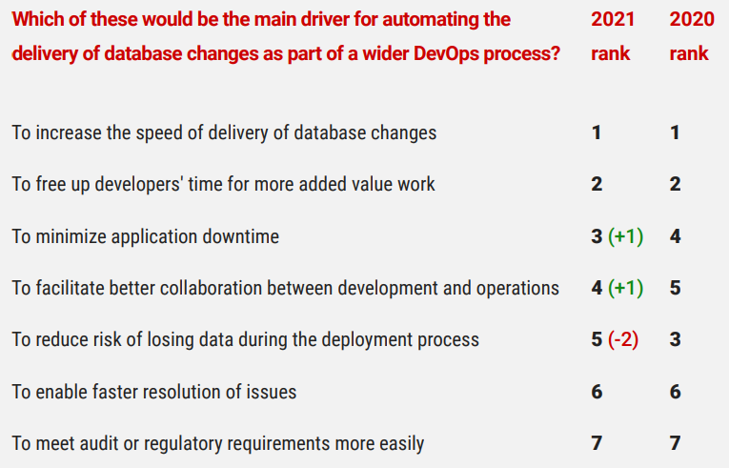
main driver for automating the delivery of database changes

Slide 6
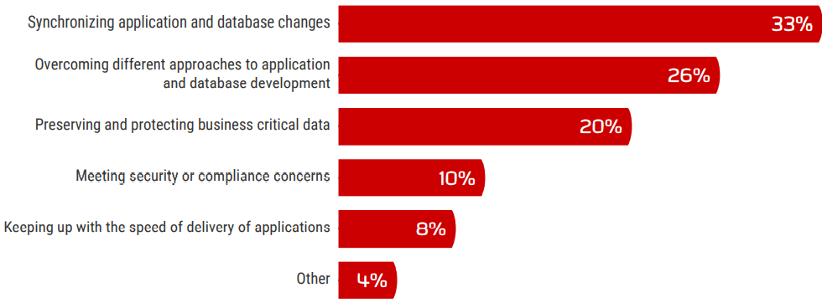
greatest challenge in integrating database changes into a DevOps process

Slide 7
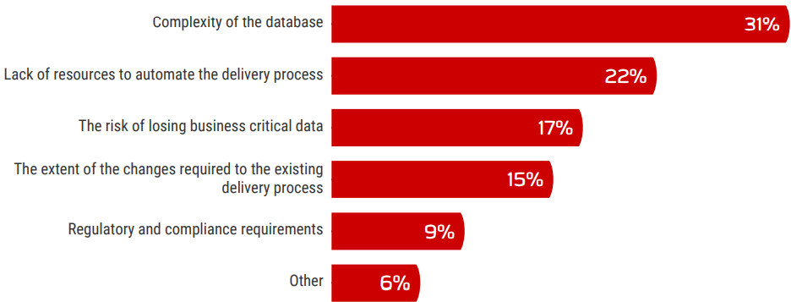
greatest challenge to achieve Continuous Delivery of database changes

Slide 8
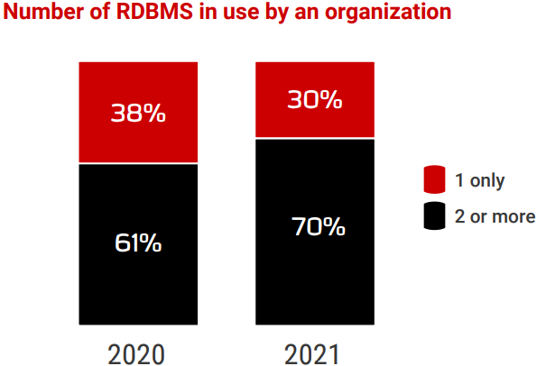
The rise of cross-database estates

Slide 9
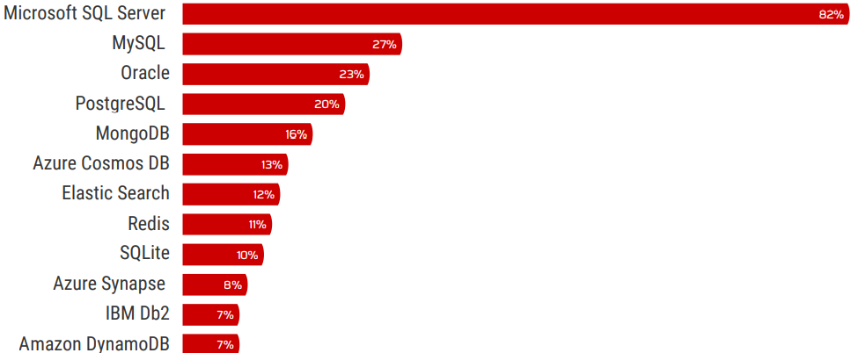
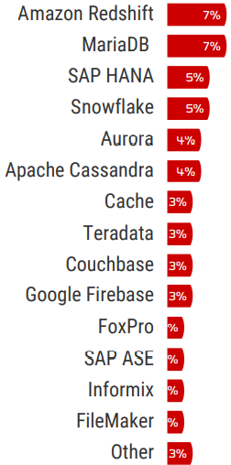
Database management systems in use

Slide 10
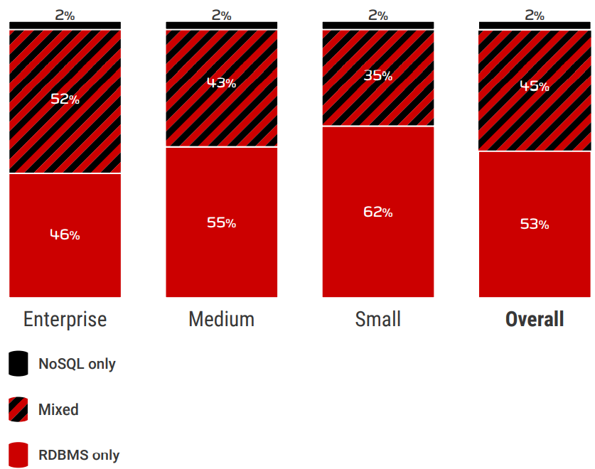
Estate types by company size

Slide 11


Slide 12
What is SSDT
SSDT is a modern development tool for building SQL Server relational databases, databases in Azure SQL, Analysis Services data models, Integration Services packages, and Reporting Services reports.
With SSDT, you can design and deploy any SQL Server content type with the same ease as you would develop an application in Visual Studio.
SSDT is required for creating a database project and for syncing your code to the Azure DevOps repository.

Slide 13
What is SSDT
Developers can use familiar Visual Studio tools for database development. Tools such as: code navigation, IntelliSense, language support that parallels what is available for C# and Visual Basic, platform-specific validation, debugging, and declarative editing in the T-SQL editor.
SSDT provides a visual Table Designer for creating & editing tables in either database projects or connected database instances.
While you are working on your database projects in a team-based environment, you can use version control for all the files.

Slide 14
What is SSDT
When it's time to publish your project, you can publish to all supported SQL platforms; including SQL Database and SQL Server.
SSDT platform validation capability ensures that your scripts work on the target you specify.
SQL Server Object Explorer allows you to do light-duty database administration and design work. You can easily create, edit, rename and delete tables, stored procedures, types, and functions.

Slide 15
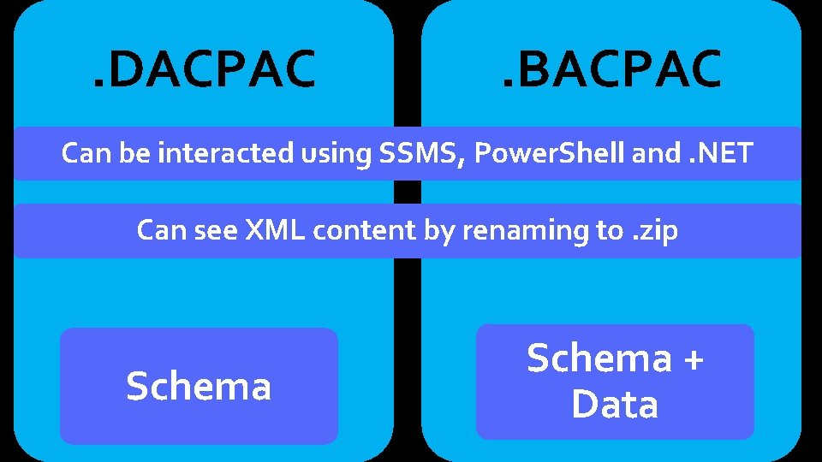
Dacpac
A DAC is a self-contained unit of SQL Server database deployment that enables data-tier developers and database administrators to package SQL Server objects into a portable artifact called a DAC package, also known as a DACPAC

Slide 16
dacpac
The advantage of a DAC-driven deployment over a script driven exercise is that:
The tool helps the DBA with identifying and validating behaviors from different source and target databases. During upgrades
The tool warns the DBA if the upgrade might cause data loss, and also provide an upgrade plan. The DBA can evaluate the plan and then utilize the tool to proceed with the upgrade.
DACs also support versioning to help the developer and the DBA maintain and manage the database lineage through its lifecycle.

